Slide 1

INSURANCE MANAGEMENT SYSTEM

Slide 2

BATCH - 04
FROND END
1.Buddareddygari
Bharat Kumar Reddy
2. Mrunalini Basavaraj
Bulbule
3. Anand Kumar Yadav
4. Chillathoti Keerthi
5. Shidhi Vinayak
BACK END
1. Pooja TG
2. Mukkala Naresh
Reddy
3. Shaik Dimple
Gousiya
4. Morumpalli Sai
Kumar Reddy
5.Thejaswi P

Slide 3
INSURANCE MANAGEMENT SYSTEM
Insurance Management System brings together all the information and processes of a insurance, in a single platform. It presents you with a unified 360-degree view for managing the policy holder details, policy details and payment details and much more.
The platform automatically generates a highly efficient process and makes it quick. Thereby, allowing hospitals to provide quality service in addition to professional policy care.

Slide 4
OBJECTIVES OF IMS
To computerize the Insurance system.
To reduce Data Redundancy.
To reduce the Cumbersome job of Maintaining several documents.
To eliminate the delays in Report Generation.
To facilitate faster Searching of information.
Thus reducing time, energy and cost.
To Give Assurance To the Policy Holders About Maintaining Data Privacy and Security.

Slide 5
Disadvantage Of Existence System
Lack of Security : The paper document is less secure compared to an electronic system.
Time Consuming : Manually managing is a very tough and time-consuming process.
Insufficient Storage Space.
Difficulty in a modification of data.
Increases Cost.

Slide 6
Scope Of IMS
1.Insurance Management System project also provides the effective
handling of any query regarding existing records.
2.This project prevents the misuse or unauthorized access to system
function a Login Id and Password identify the User of the system.

Slide 7

MAIN MODULES OF INSURANCE MANAGEMENT SYSTEM
Admin
User
Organizer

Slide 8
a)Admin module: This module allows only registered members to log in
and manage the users and organizer.
b) Organizer module: This module allows to known the premium
details of the users who buy the policies and policy details.
c) User module: This module allow the user to view all the policies and
they can buy it according to their need.

Slide 9

Sub Modules Of Admin
Home
View Policy Booking
View Policies
Organizers
Users

Slide 10
Sub Modules Of Organizer
Home
Manage Policy
View Booking
Booking History
Notification
Organizer Profile

Slide 11
Sub Modules Of User
Home
Apply Policy
View Policies
Booking History
Notification
User Profile

Slide 12
REQUIREMENT SPECIFICATION
OPERATING SYSTEM : Windows 10
FRONT END : Angular
SERVER SIDE SCRIPT : Apache tomcat 8
DATABASE : MySQL
TESTING : J Unit testing
BACKEND : Spring Boot

Slide 13
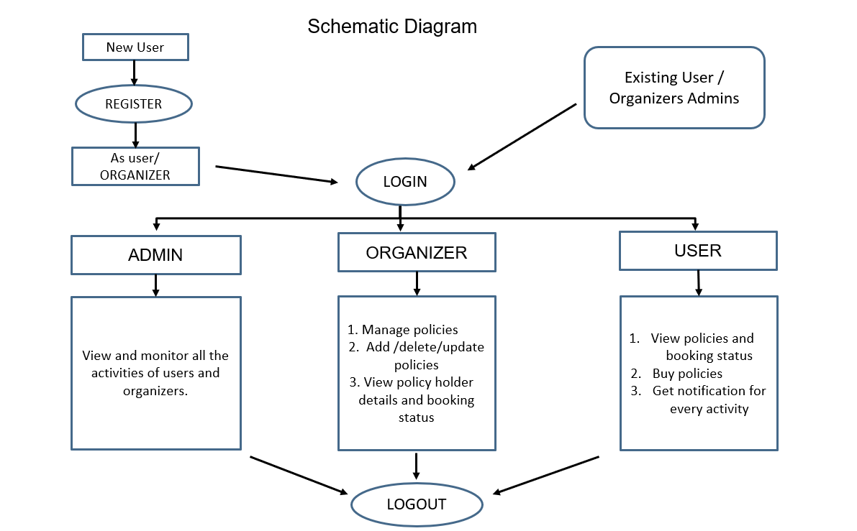

Slide 14
ASSUMPTION
1. Each user(Admin, organizer, user) must have a valid user id and
password.
2. Server must be running for the system to function.
3.Users must login to the system to buy and view any policies.
4.Only the Organizer can update and delete the policies.
5.Only admin can view and monitor all the records present in the
platform

Slide 15
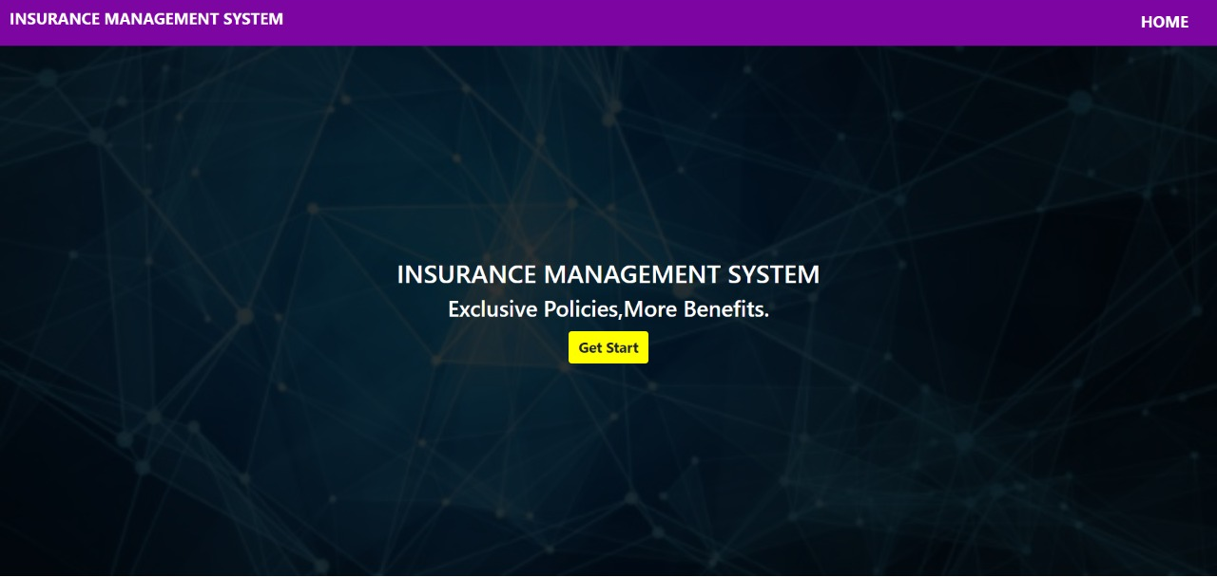
Welcome Page

Slide 16
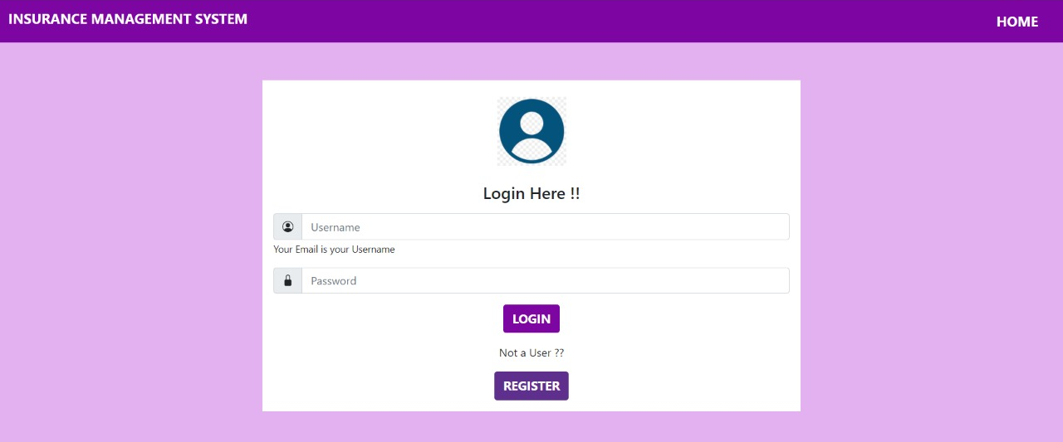
Login Page
This is the login page for admin , user and organizer.

Slide 17
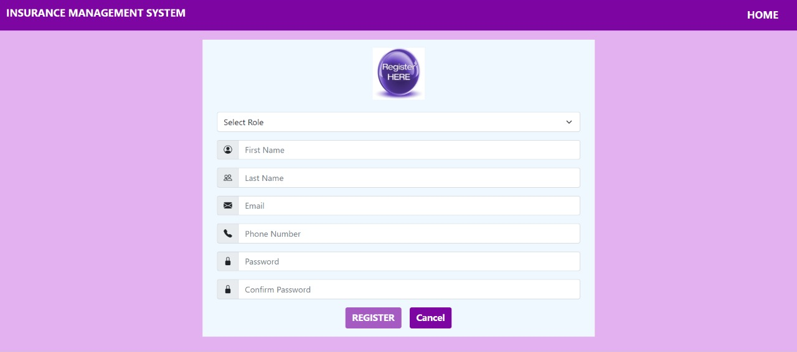
Registration Page For User And Organizer
This page is used for new users and organizer to register into portal.

Slide 18
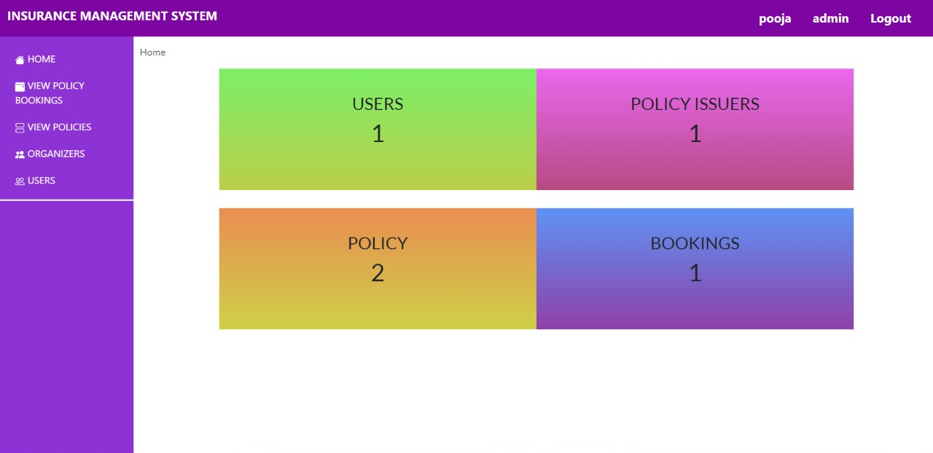
Admin : Home
Once after successful admin login, we will get homepage .Where we can view policy bookings, view policies, organizers and user.

Slide 19
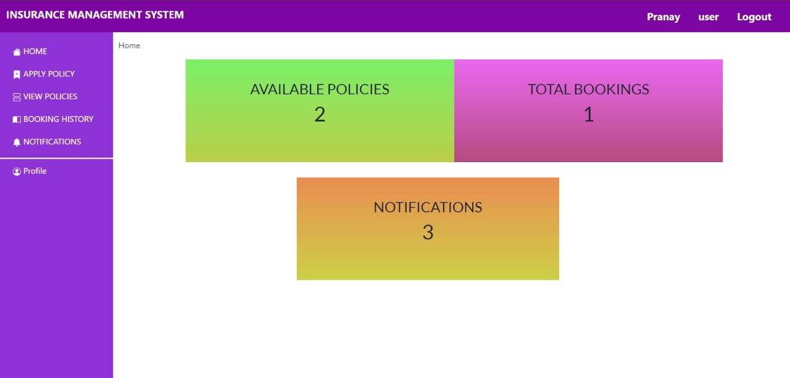
User : Home
After successful registration of user, we will get the homepage. Where we can see Apply policy, View policy, Booking History, Notifications and profile.

Slide 20
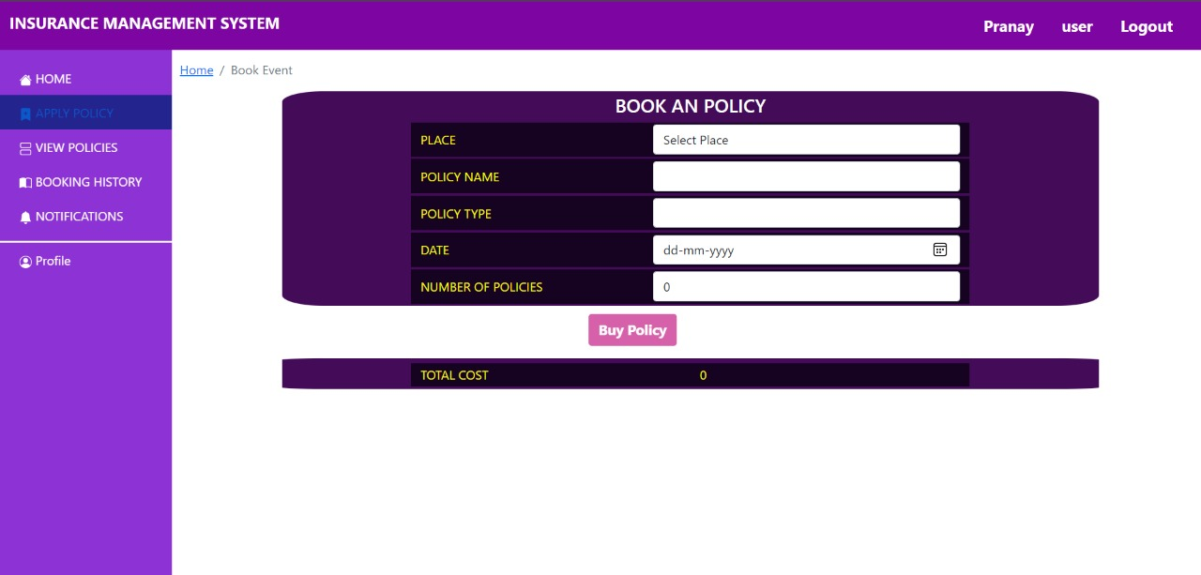
User : Policy Booking Page
From this page user can add policy and buy policy.

Slide 21
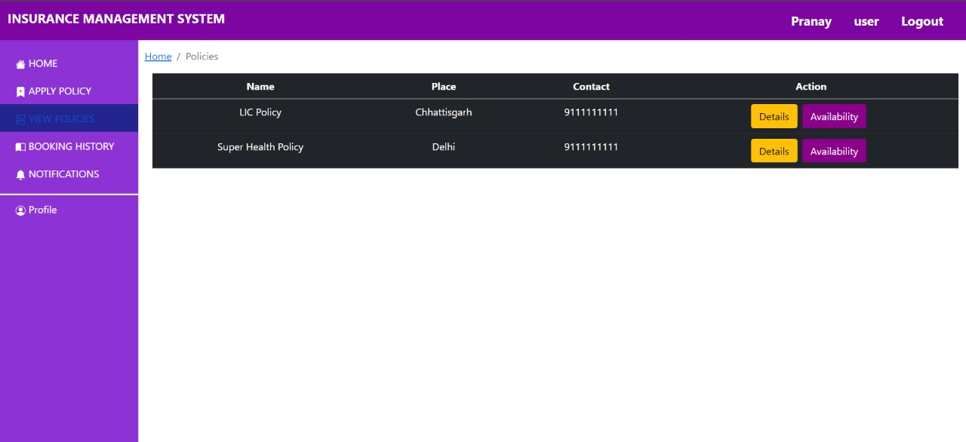
User : View Available Policies
From this page user can view all the policies which are available in the platform.

Slide 22
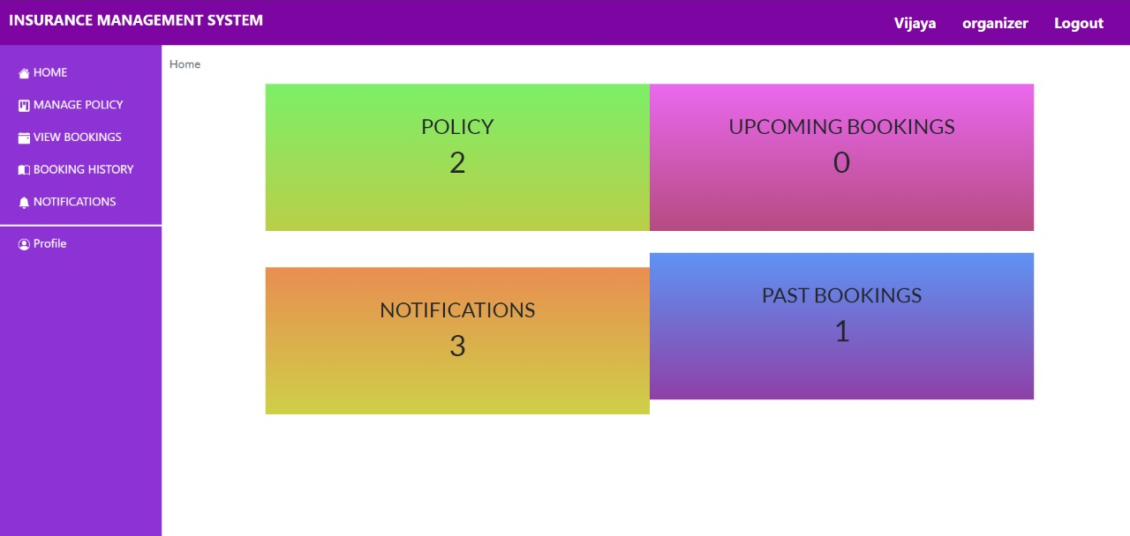
Organizer : Home
Once after successful organizer login, we will get this homepage, where we can view manage policy, view bookings, booking history, notification and profile.

Slide 23
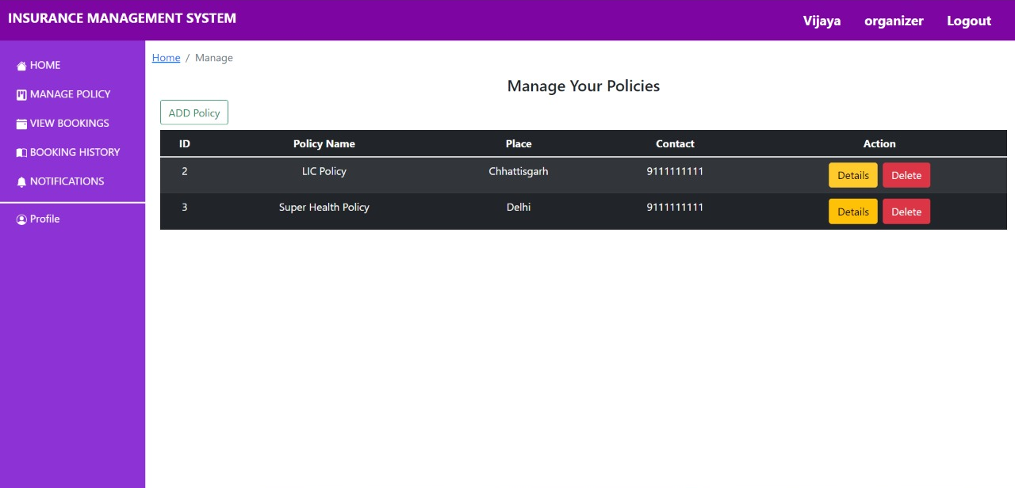
Organizer : Manage Policy Page
From this page we can add policies and view all the existing policies.

Slide 24
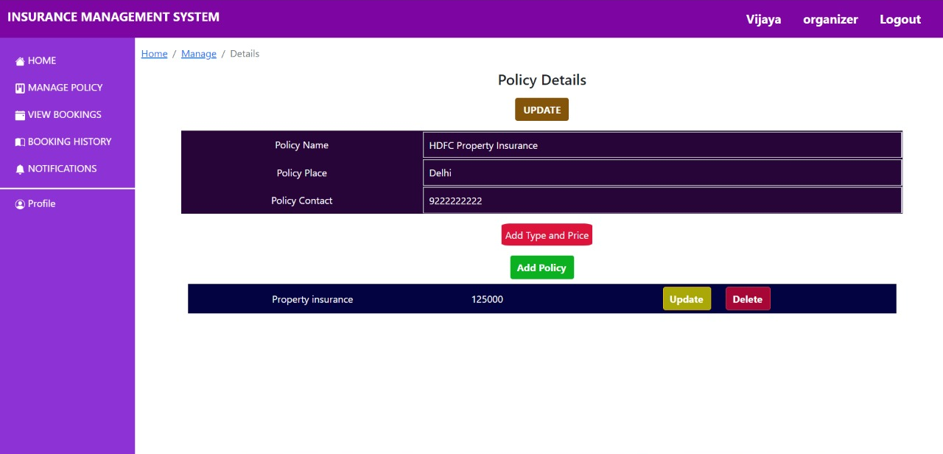
Organizer : Add/ Update/ Delete Policy
From this page the organizer can add, update and delete policy.

Slide 25
CONCLUSION
Insurance management system is all about the modernizing a insurance company through use of technology. Computers helps in it and take over the manual system for quick and easy functioning. This insurance management system is a quite the reliable and is proven on many stages. All the basic requirements of the insurance company are provided here in order to manage it perfectly and large amount of data can also be stored . It gives many facilities like searching for the detail of policies, available policies as well as buying facilities . So its a important system for modern days.

Slide 26
THANK YOU

